Slide 1
Low-Thrust Satellite Trajectory Optimization
-Vasanth Gogineni

Slide 2
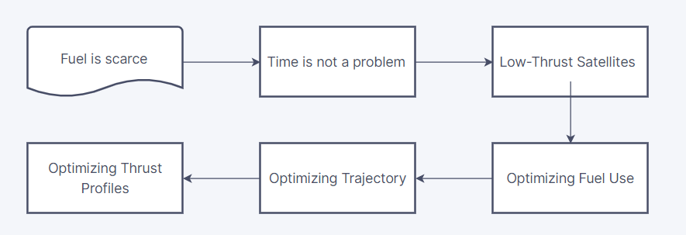
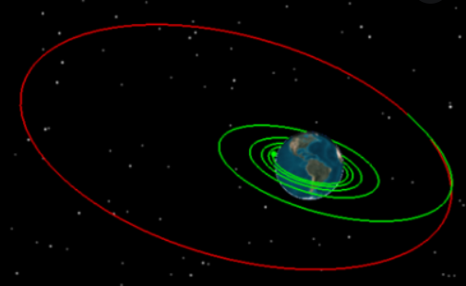
Abstract of Project
Discrete Time Trajectory Optimization
Orbit-Lowering Maneuvers
Fuel Constraints

Slide 3
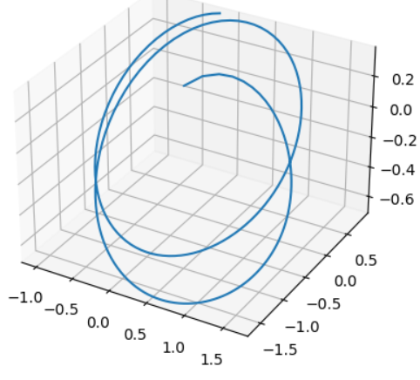
Example

Slide 4
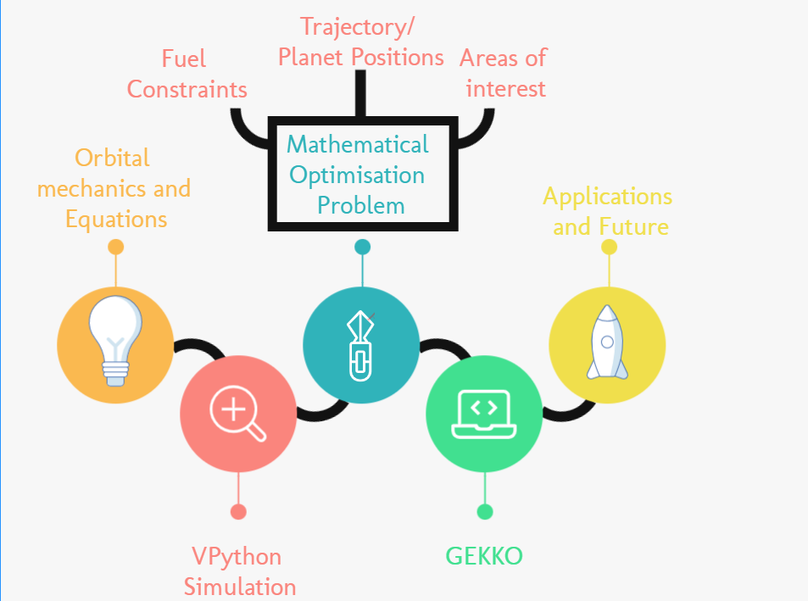
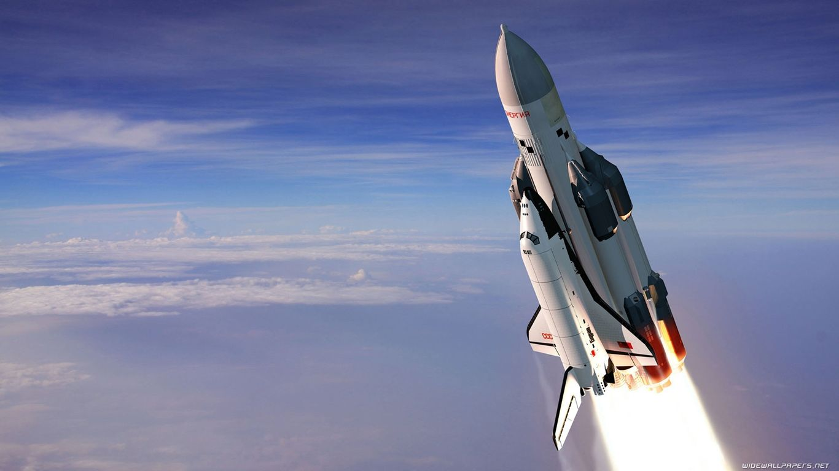
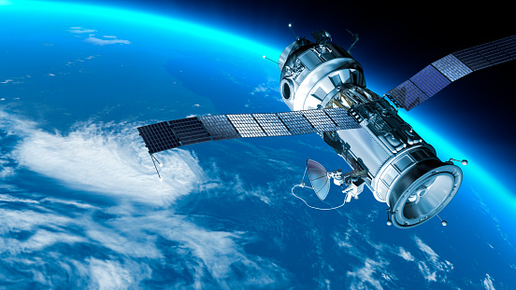
Road Map

Slide 5

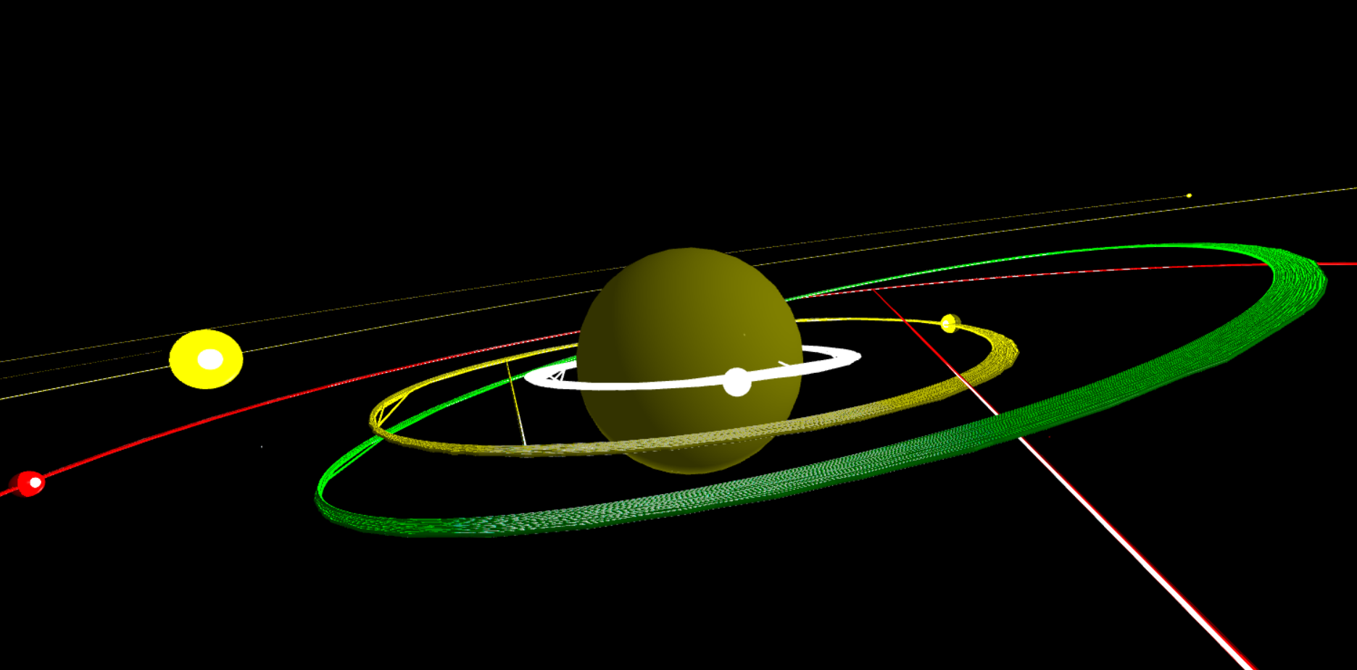
VPython Simulation
localhost://58124

Slide 6
Road Map

Slide 7
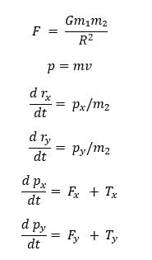
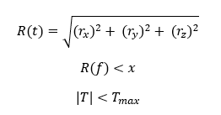
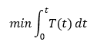
Quantities/Variables
Force
Momentum: Differential Equation
Thrust
Distance
Position
Differential Equations (Rate of change)
Position
Acceleration
Velocity
Objective
Minimized thrust profile
Variables and Changing Quantities

Slide 8
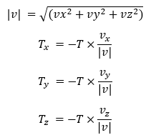
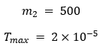
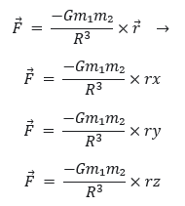
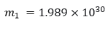
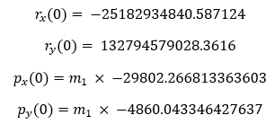
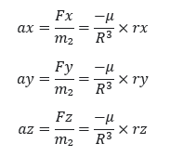
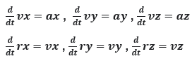
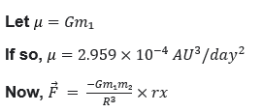
Mathematical Optimisation

Slide 9
Road Map

Slide 10
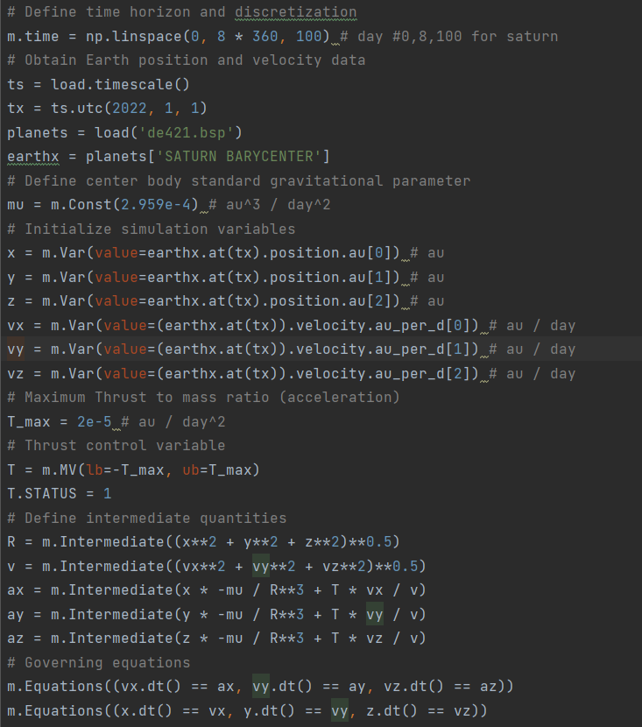
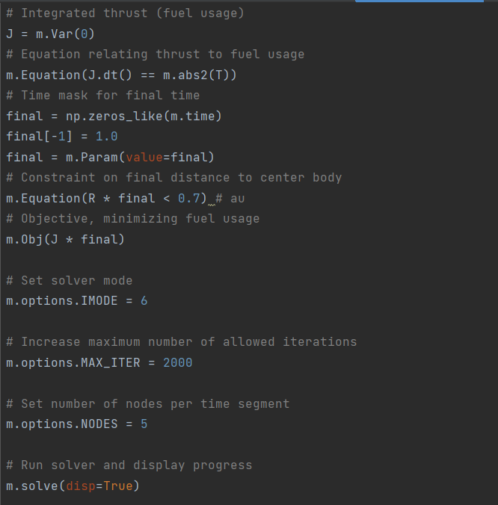
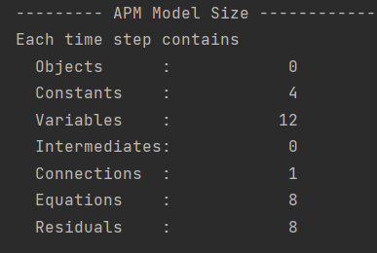
GEKKO Python Implementation

Slide 11
RESULTS

Slide 12
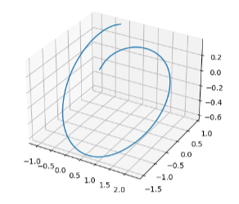
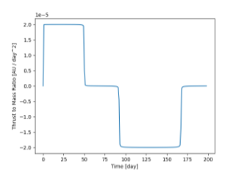
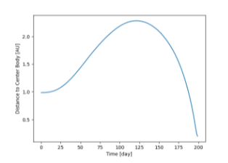
READING THE GRAPHS
Thrust Profile
Positive is forward thrust and negative is reverse thrust
Distance from the Sun with time
Satellite Trajectory/Path

Slide 13
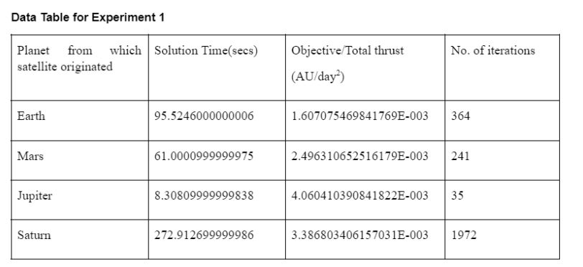
RESULTS OF EXPERIMENT 1
Experiment changing the initial distance from the Sun

Slide 14
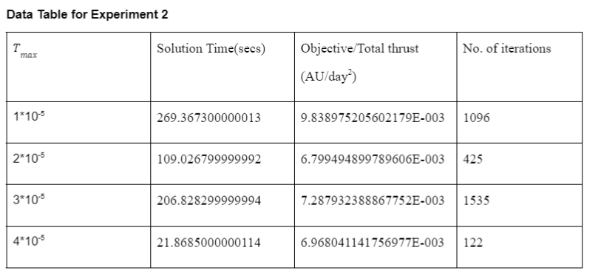
RESULTS OF EXPERIMENT 2
Experiment changing the maximum thrust the satellite has

Slide 15
Road Map

Slide 16
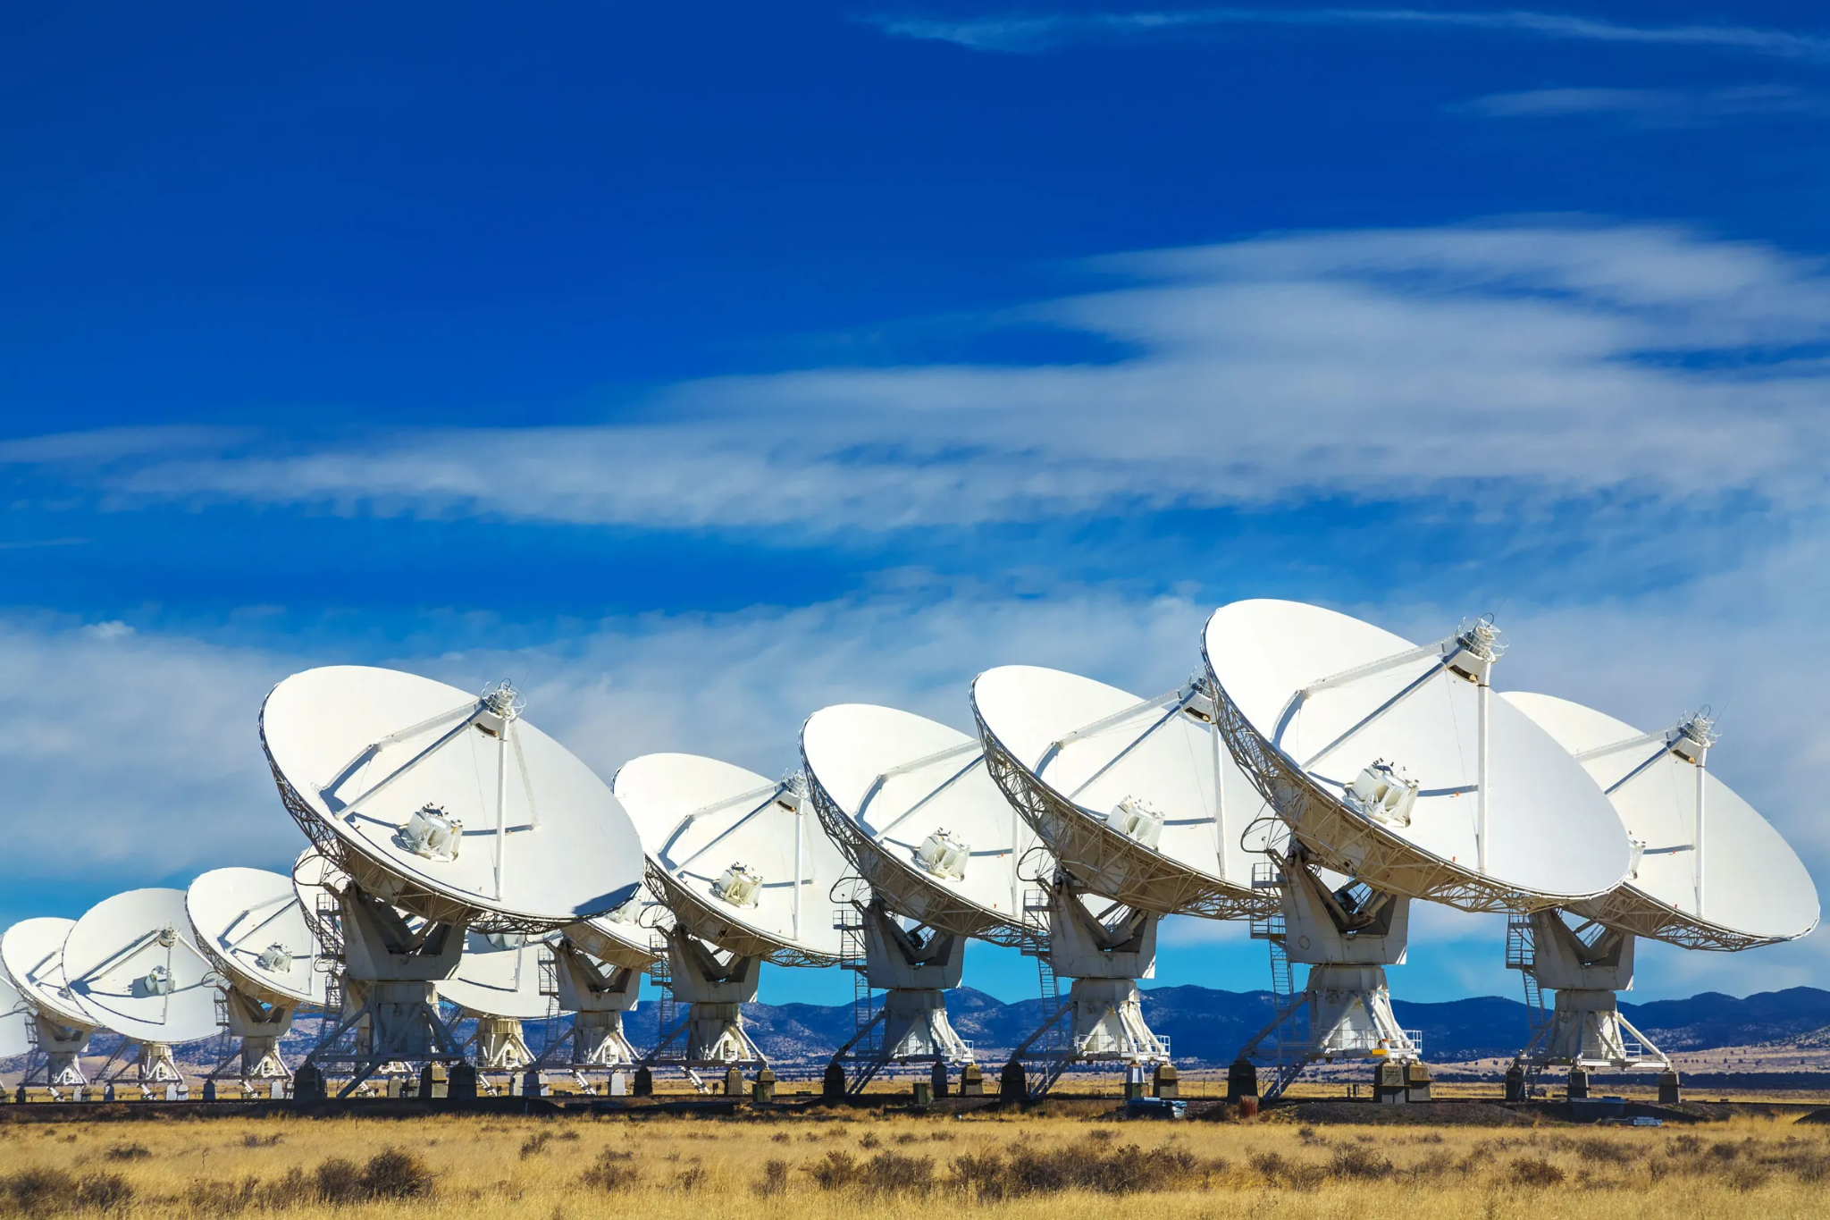
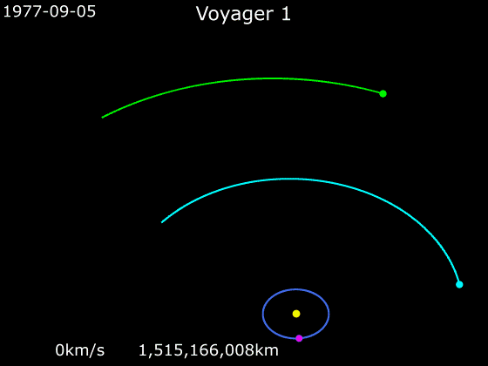
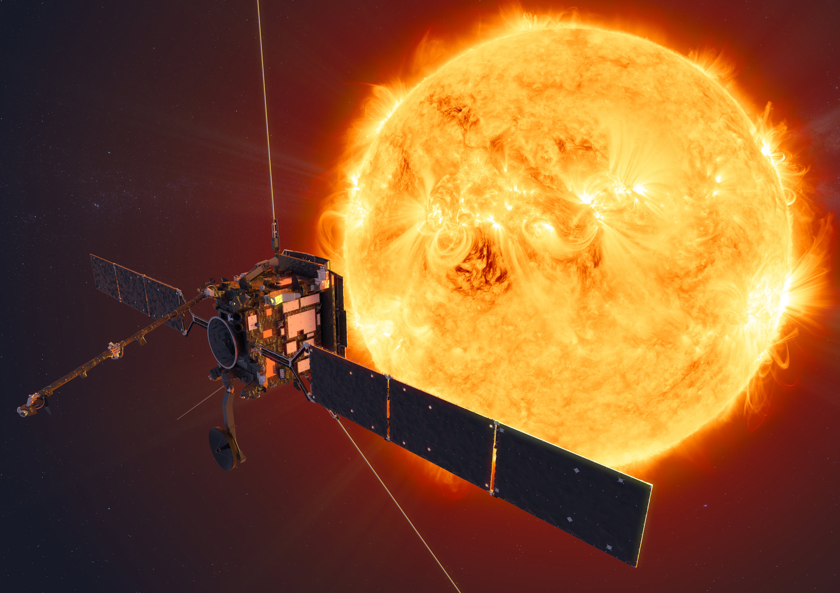
Applications and Future
Optimising Satellite Paths
Around Earth as the central body
Inter-planetary satellite trajectory optimization
Finding optimum thrust profiles and feasibility of time and fuel-constrained missions
Optimising Orbit Raising Maneuvers
Example: Voyager 1

Slide 17
-Vasanth Gogineni
-Thanks to my mentor: Maitreya V.

